Slide 1


Green Pace
Security Policy Presentation
Developer: Eric Breznen

Slide 2


OVERVIEW: DEFENSE IN DEPTH
Security principles
Coding standards
Automations
Unit Testing
Triple-A framework

Slide 3

THREATS MATRIX
Data Values String Correctness Expressions | SQL Injection Memory Protection Containers
Data Types Exceptions | Assertions Object Oriented Programming

Slide 4

10 PRINCIPLES
Validate Input Data
Data Types
Heed Compiler Warnings
Containers
Expressions
Architect and Design for Security Policies
Memory Protection
Exceptions
Object Oriented Programming
Containers
Keep it Simple
Data Values
Object Oriented Programming
Default Deny
SQL Injection
Containers.

Slide 5

10 PRINCIPLES
Adhere to the Principle of Least Privilege
Sanitize Data Sent to Other Systems
String Correctness
SQL Injection
Practice Defense in Depth
Containers.
Use Effective Quality Assurance Techniques
Assertions
Expressions
Adopt a Secure Coding Standard

Slide 6

CODING STANDARDS
Data Type - [STD-001-CPP] - Validate user input for proper data types.
Data Value - [STD-002-CPP] - Use data types that dynamically allocate memory.
String Correctness - [STD-003-CPP] - Format Strings with user input when entering into pre-written sentences.
SQL Injection - [STD-004-CPP] - Check for SQL code in user input and reject if found.
Memory Protection - [STD-005-CPP] - Clear std::cin buffers when rejecting input.

Slide 7

CODING STANDARDS
Assertions - [STD-006-CPP] - Use assertions to assist with validating data during development, best not to use assertions post release.
Exceptions - [STD-007-CPP] - Do not abruptly terminate program.
Object Oriented Programing - [STD-008-CPP] - Write constructor member initializers in declaration order.
Containers - [STD-009-CPP] - Use valid ranges for iterating through containers.
Expressions - [STD-010-CPP] - Do not access an object before it is initialized or after it is destroyed.

Slide 8

ENCRYPTION POLICIES
Data
At Rest – Stored using a hashing algorithm.
In Flight – Encrypted with an RSA algorithm.
In Use – Must be unencrypted for secure operations, other safeguards necessary.

Slide 9

TRIPLE-A POLICIES
Authentication – Only people with access should have access
Authorization – Adhere to principle of least privilege
Accounting – Record keeping and user action logs

Slide 10

Unit Testing - Overview
Should be thorough
Know that it is impossible to test every possible input.
Include Median and Edge Cases
Test for Positive and Negative results
Test Ourselves Too

Slide 11
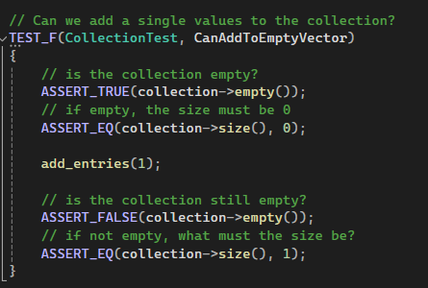


Unit Testing – Can we add values to the collection?

Slide 12
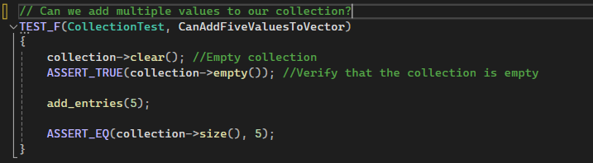


Unit Testing – Can we add values to the collection?

Slide 13
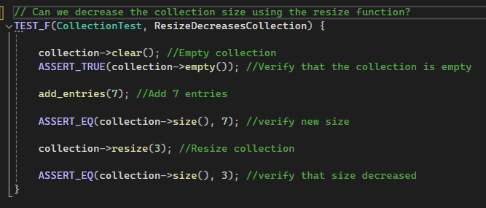


Unit Testing - Resizing

Slide 14
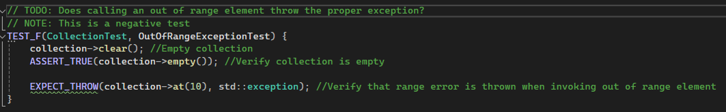


Unit Testing – Does the exception get thrown?

Slide 15
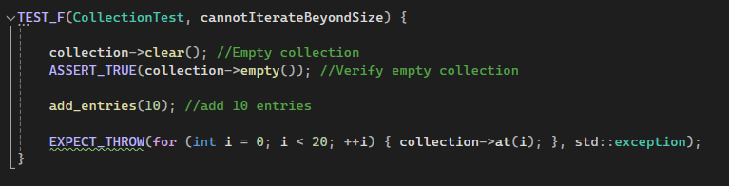


Unit Testing – Does the exception get thrown?

Slide 16


AUTOMATION SUMMARY

Slide 17

TOOLS
SEI CERT
CPPCheck – 24.9.0
CodeSonar - 8.1p0
Parasoft C/C++ test - 2023.1
Polyspace Bug Finder - R2024a

Slide 18

RISKS AND BENEFITS
Waste of time, money, and manpower
Avoidable vulnerabilities
Limiting the amount of rework
Design with Security in Mind

Slide 19

RECOMMENDATIONS
Review and update security policy annually

Slide 20

CONCLUSIONS
Additional Security Training

